Slide 1
Celery Architecture
(because onions make you cry)

Slide 2




About Garo Yeriazarian
SOFTWARE WHISPERER
~16 years in the business (more or less)
Helping people solve problems
MANAGER, LEADER, FUNGI
Spreading mirth and merriment and software
Resolving conflict, finding a better way
HOUSTONIAN
BS CS and MBA from University of Houston
Involved with various software communities
@garoyeri
https://headspring.com/author/garabed-yeriazarian/
Icons made by www.flaticon.com/authors/freepik Freepik from www.flaticon.com
Icons made by www.flaticon.com/authors/dave-gandy from www.flaticon.com

Slide 3

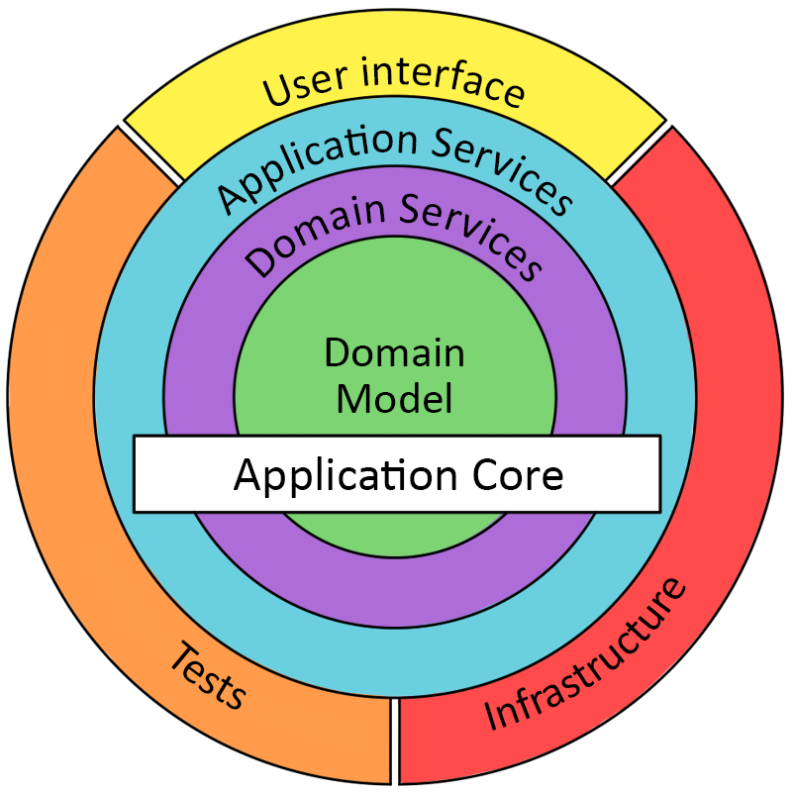
What is Onion Architecture?
https://dzone.com/articles/onion-architecture-is-interesting https://jeffreypalermo.com/2008/07/the-onion-architecture-part-1/
© User:Colin / Wikimedia Commons https://commons.wikimedia.org/wiki/File:Onion_on_White.JPG

Slide 4
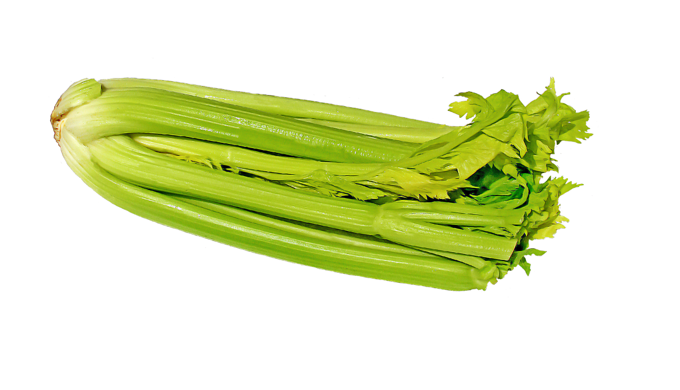
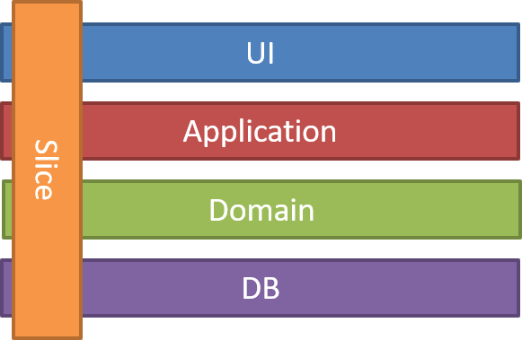
What is Celery Architecture?
https://jimmybogard.com/vertical-slice-architecture/ https://www.needpix.com/photo/344249/celery-vegetables-vegetable-green-free-pictures-free-photos-free-images-royalty-free

Slide 5

Demo Time
(cross your fingers)
https://www.svgrepo.com/svg/154319/celery

Slide 6
Anatomy of a Request
ASP.NET Core Route
Begin Transaction
Controller Action
Mediator Pub / Sub
Return Action Result
Commit Transaction
Exception Handler
Rollback Transaction
HTTP Request
React Route
Render
Component

Slide 7
Why Celery Architecture?
JUST ENOUGH ARCHITECTURE
Build just enough architecture for your application
The code you don’t write has no bugs
CODE ORGANIZATION
Feature work requires little context switching
Happier pull-requests (all related work is together)
EASY TO SWAP OUT FEATURES
When changing implementations, just change Handler
USE FEATURES DURING TESTING
When unit testing, use the full features, not mocks

Slide 8
Other Useful Links
JIMMY BOGARD: VERTICAL SLICE ARCHITECTURE
https://jimmybogard.com/vertical-slice-architecture/
JIMMY BOGARD: CONTOSO UNIVERSITY CORE
https://github.com/jbogard/ContosoUniversityDotNetCore
USE THE REACT PROJECT TEMPLATE WITH ASP.NET CORE
https://docs.microsoft.com/en-us/aspnet/core/client-side/spa/react
MEDIATR
https://github.com/jbogard/MediatR
AUTOMAPPER
https://automapper.org/
THIS DEMO IN GITHUB
https://github.com/garoyeri/celery-architecture-demo

Slide 9
Questions
Comments
Queries
Concerns?

Slide 10
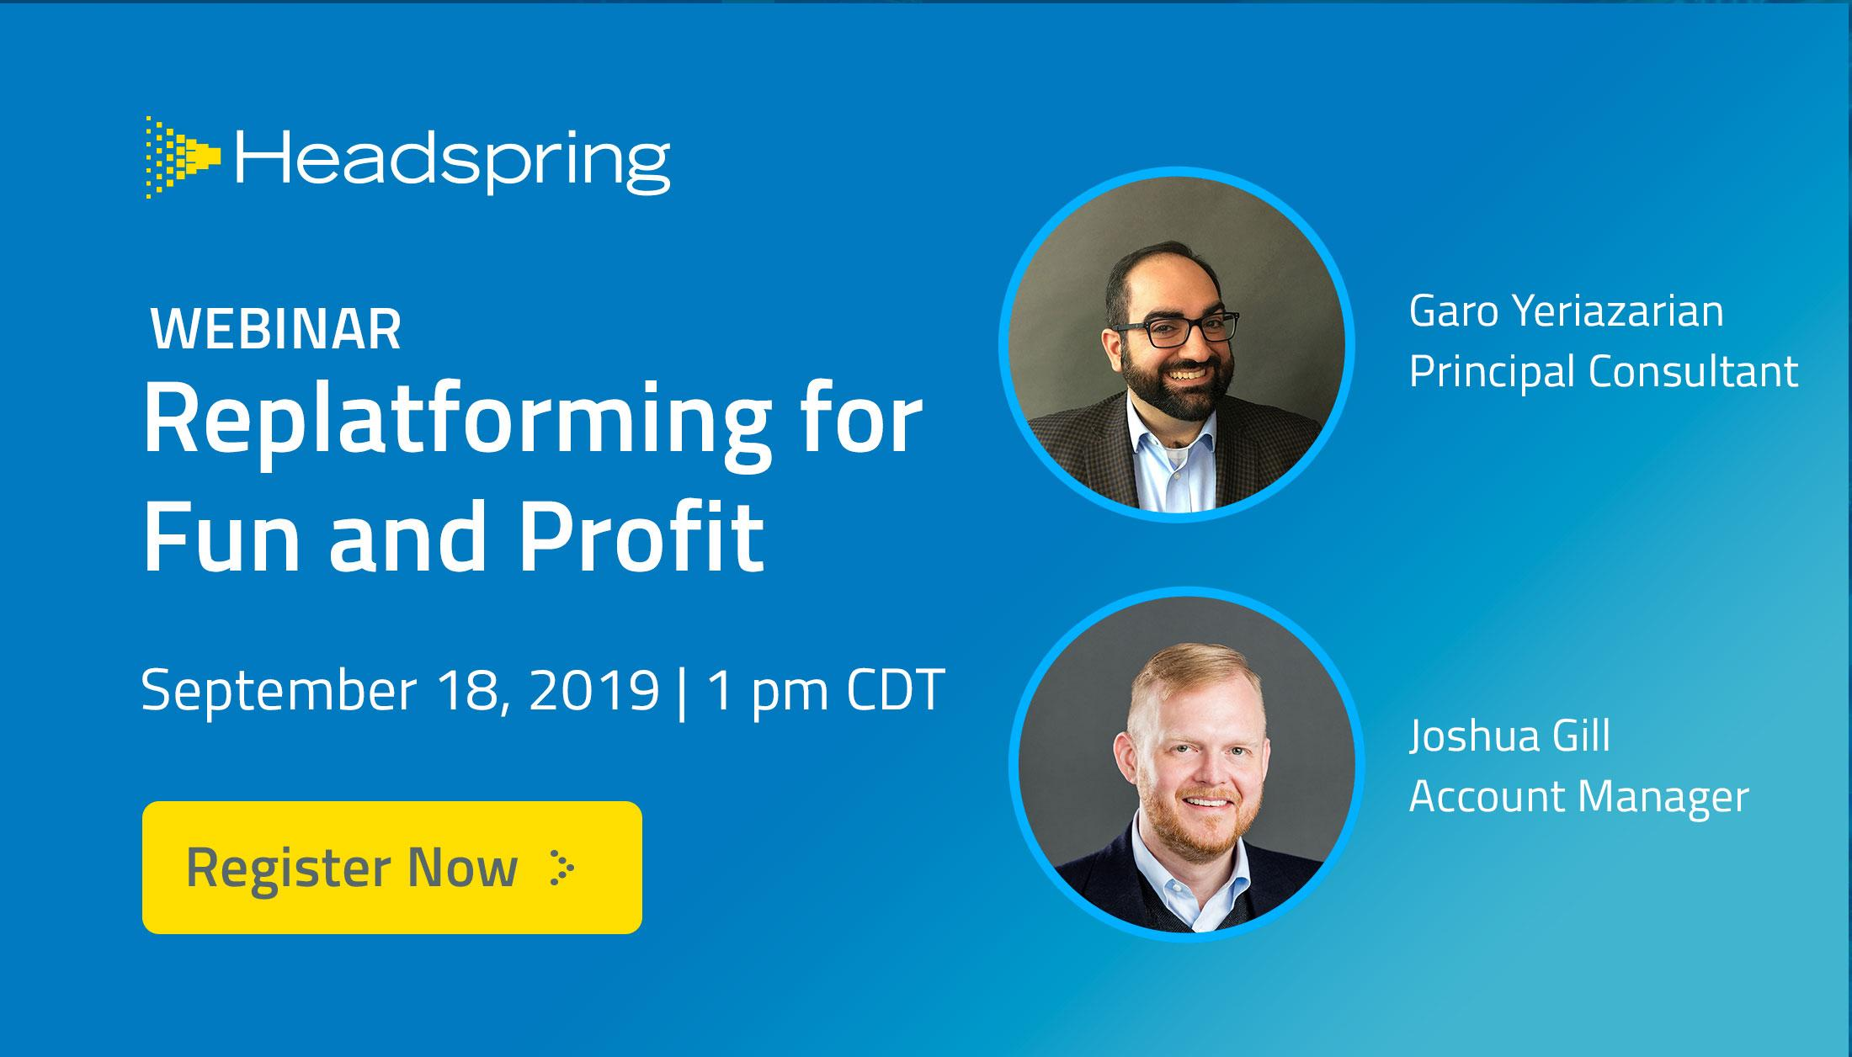
headspring.com/about/events

